Slide 1
Trip Finder Scenario Automation
Tools :
Eclipse with Selenium Webdriver
and TestNG
Language: Java
Nazmul Haque
Automation Development Engineer
Primary Health Care Ltd

Slide 2
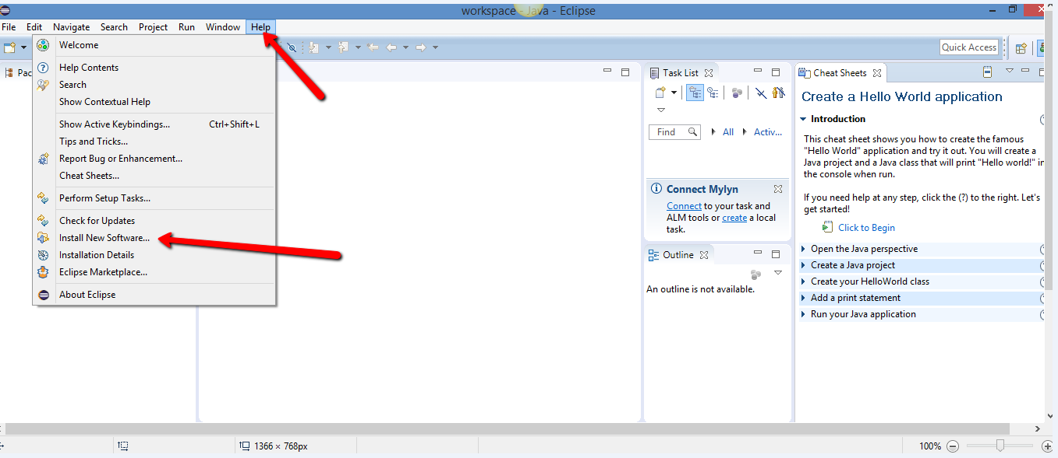
Setting up Eclipse
I use windows version of Eclipse if you have not got Eclipse installed yet you can
Download and install it from : http://www.eclipse.org/downloads/?
Once you have installed it now plugin TestNG (TestNG helps reporting side of test)
into the Eclipse as shown below:

Slide 3
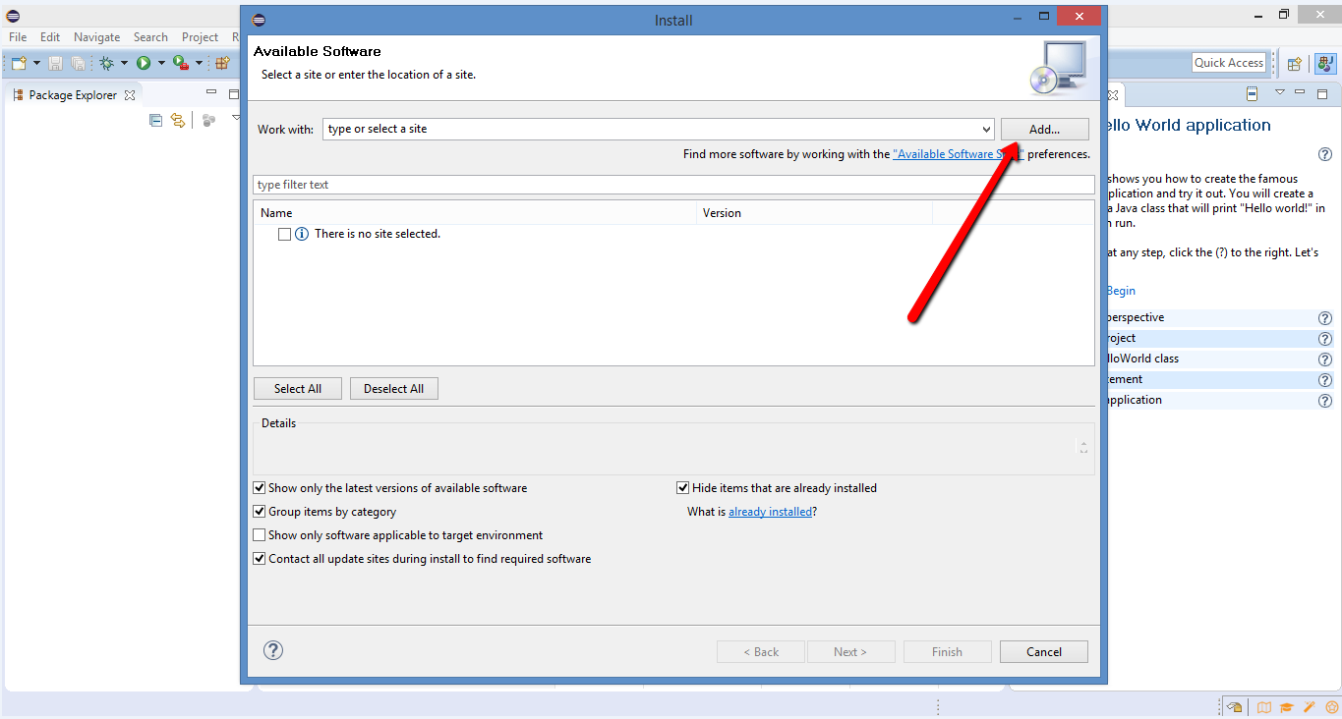
Setting up Eclipse

Slide 4
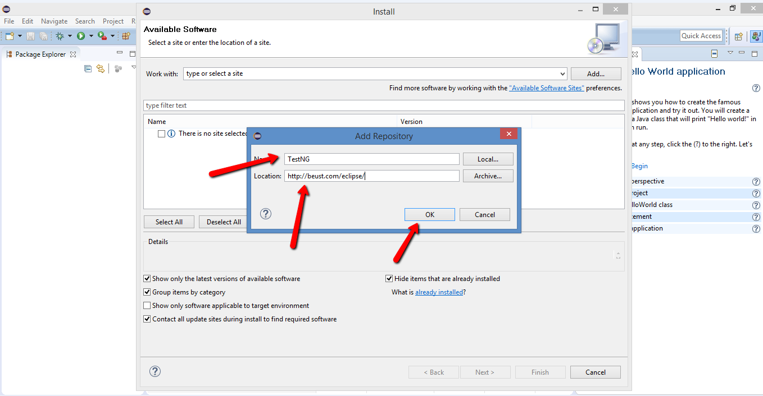
Setting up Eclipse

Slide 5
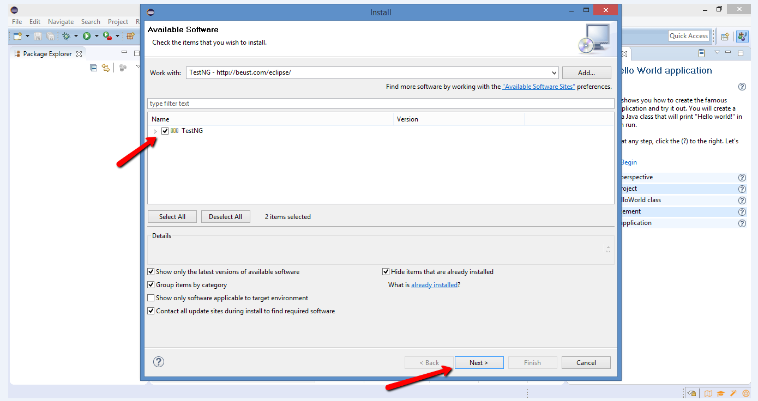
Setting up Eclipse

Slide 6
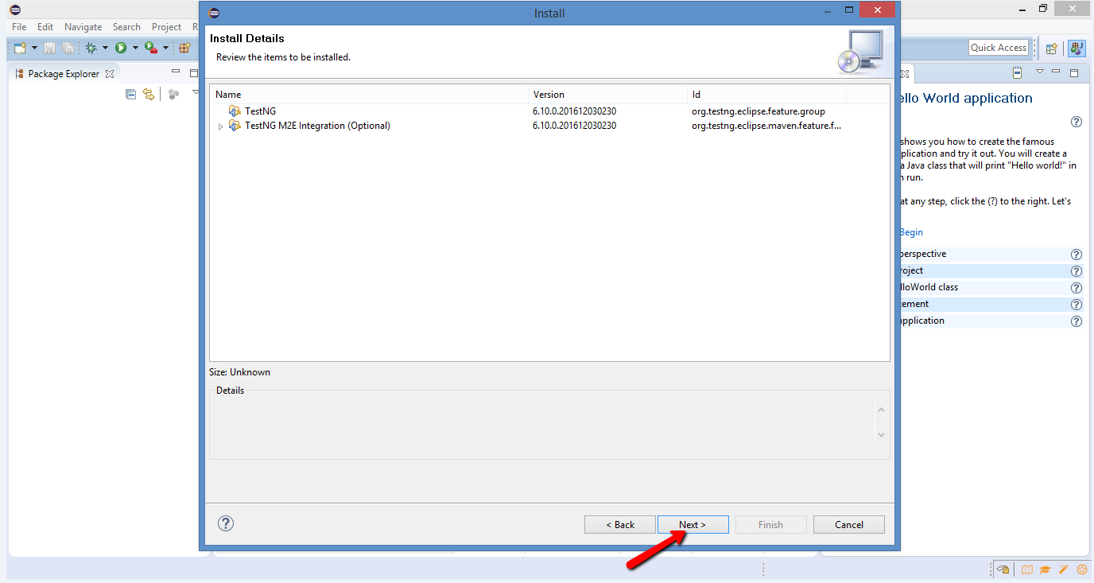
Setting up Eclipse

Slide 7
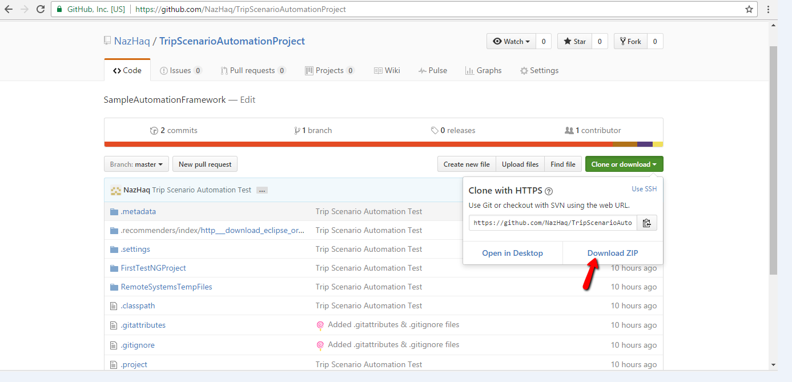
Project Location/Download
Once that finished now download the preliminary project that I have created and committed in GitHub: https://github.com/NazHaq/TripFinderAutomationTest

Slide 8
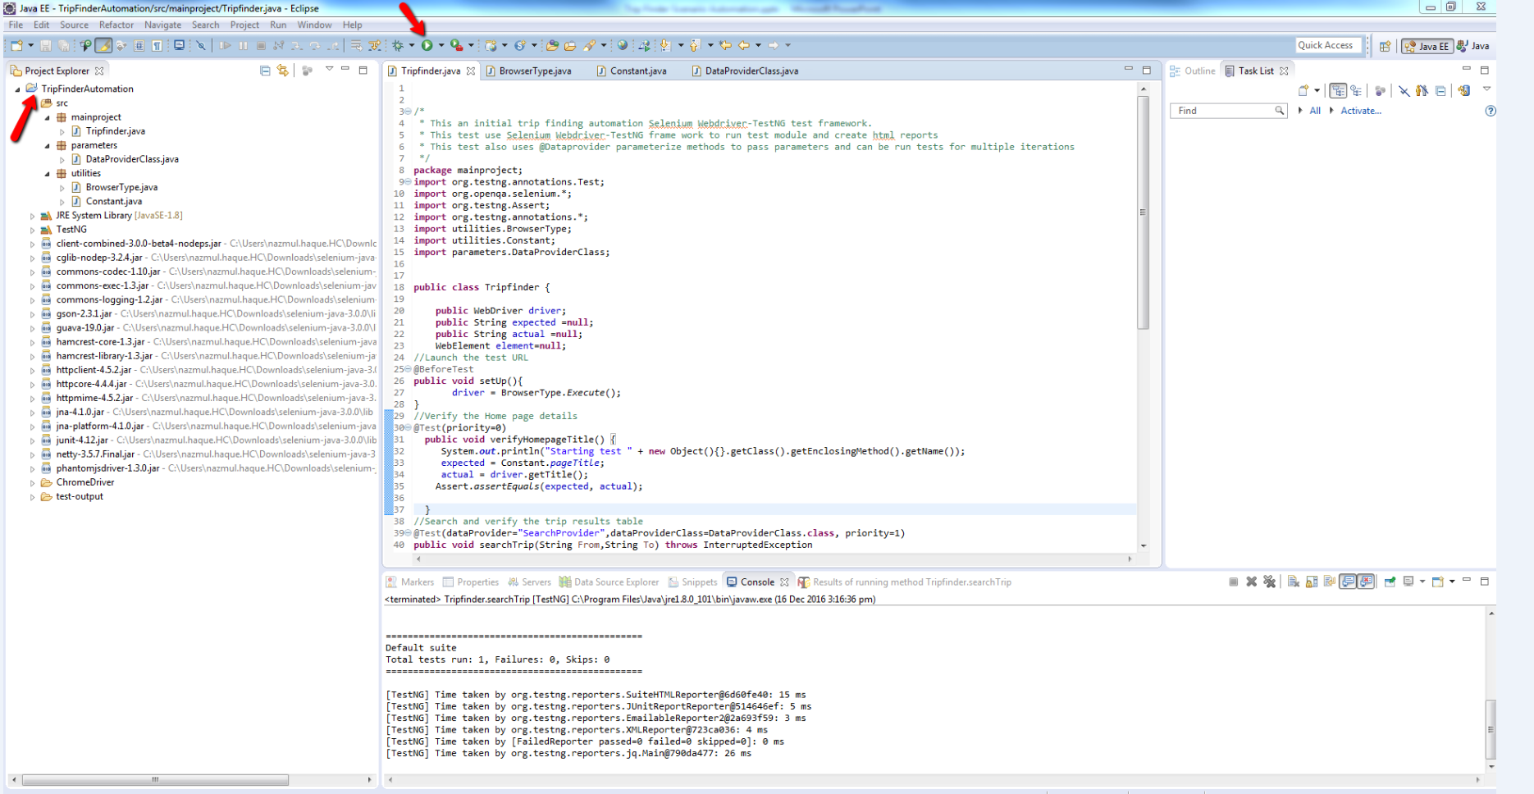
Open The Project in Eclipse
Before running the project you need to add selenium webdriver into your project.
If you have not done it yet please go to next slide and then run the test.

Slide 9
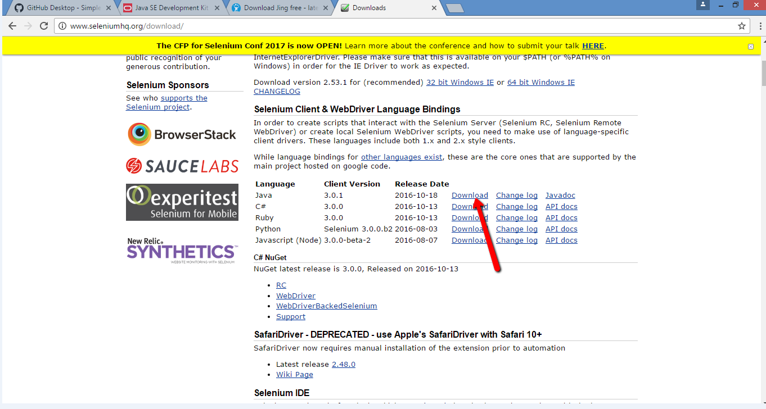
Downloading Selenium Webdriver
Download the Selenium webdriver java library from: http://www.seleniumhq.org/download/

Slide 10
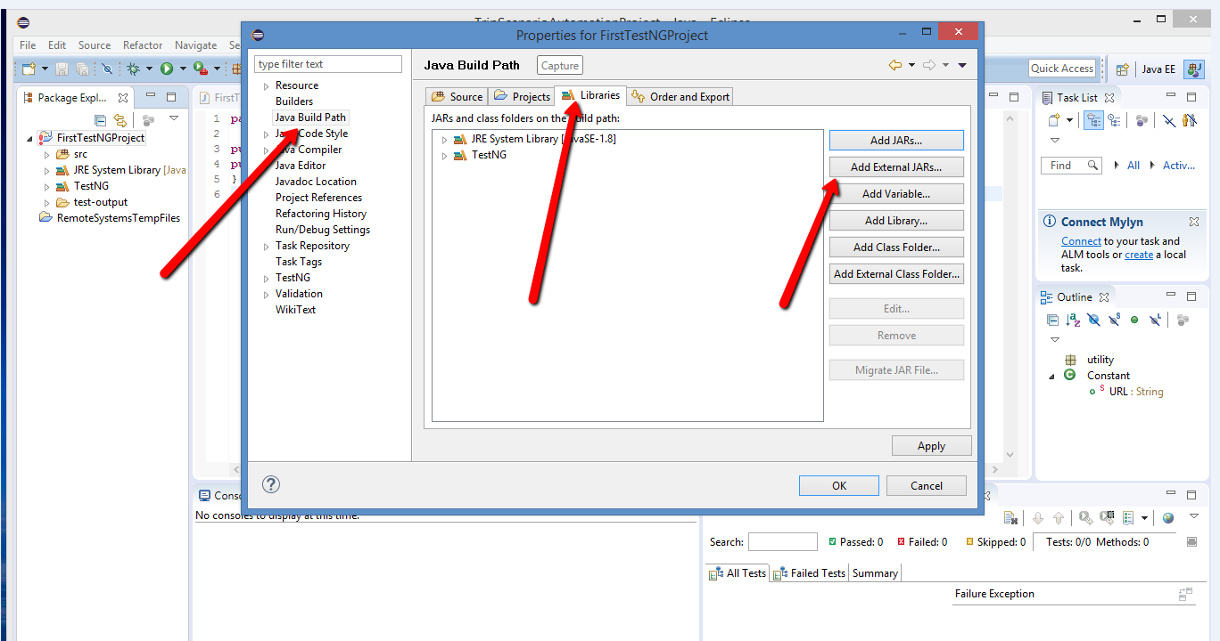
Adding .Jar files
Right click on the project explorer>Java build path>Libraries>Add External JARS
Add both main JAR and Jars from lib folder.

Slide 11
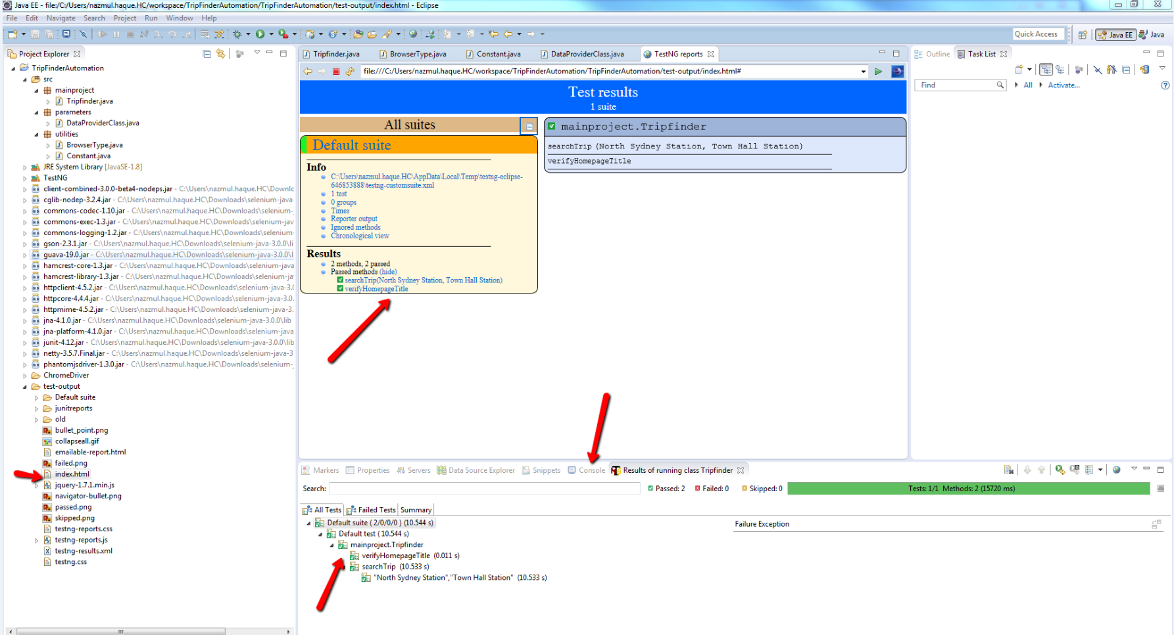
Test Results

Slide 12
Next steps
More combination of input filters can be selected and applied to verify search results.
Advanced search could be applied for instance ticking/un-ticking the Train, bus etc.
More input combinations of From and Destination can be added into dataproviderclass that will iterate based on the number of combinations provided.
Links, Earlier, expand all, share.. on the search result page can be clicked and verified whether they open corresponding page.
Input filter field can be cleared and re-intered and verified the search results again.
Different tabs (Next departure, Beta trip plan) can be selected and verify the search
feature.
Could be captured a screen shot and compare image to verify Map view.
Links on the right side and footers can be verified whether clicking upon they open the corresponding page.
Last but not the least more actions and verifications could be done based on time and resource available.

Slide 13
Tips
I have included all the libraries but some of the jar files might need to be updated.
Source code location in GitHub: https://github.com/NazHaq/TripFinderAutomationTest

